Slide 1
Spring 3D Printing Workshop
By Henry Kou and Evan Brown

Slide 2
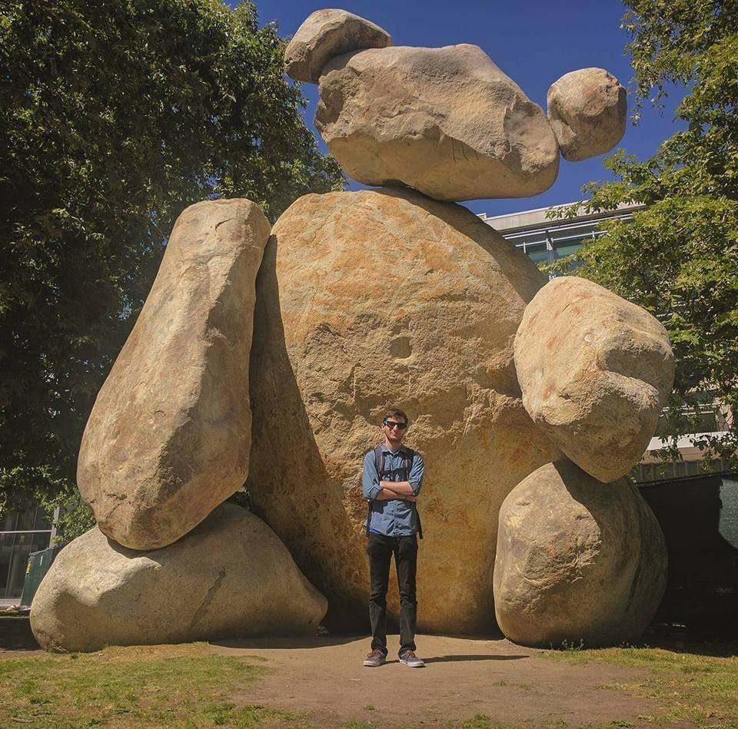

Intro
Evan Brown
3rd Year EE
IEEE Workshop Lead
Henry Kou
2nd Year EE
IEEE Workshop Plebe

Slide 3
Free Download software
Pls Download both! Useful for PCB design, 3D CAD as well
Fusion 360: Sign in with educational acc, school email
https://www.autodesk.com/products/fusion-360/students-teachers-educators
Prusa Slicing Software
https://www.prusa3d.com/drivers/

Slide 4
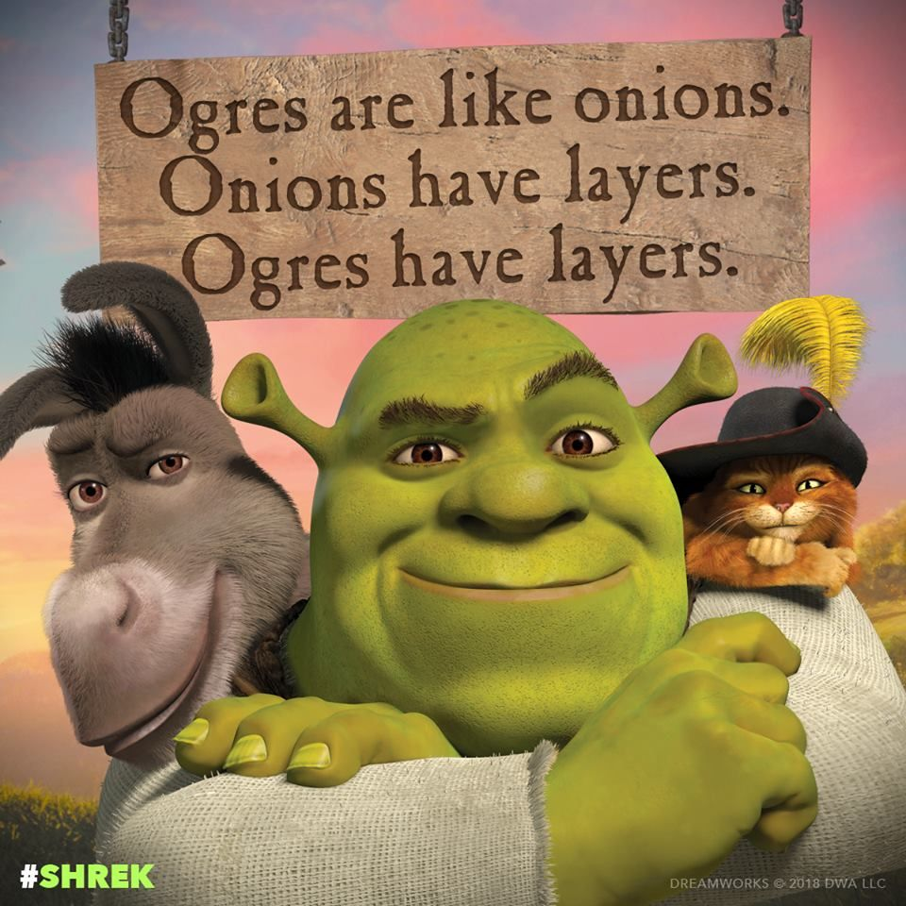
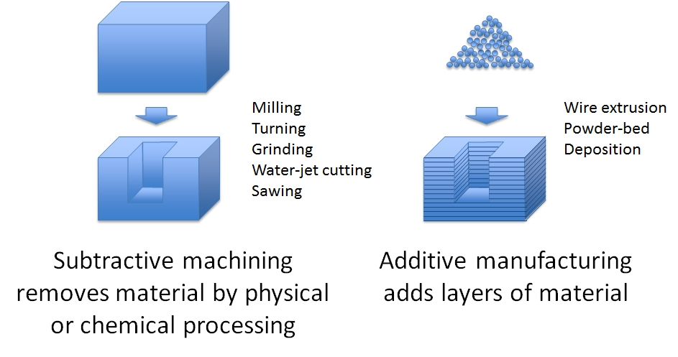
Overview:
What is 3D Printing?
Process of making a 3D solid object from a digitally designed file.
Printer Analogy: Just like a printer uses ink to make sentences, additive manufacturing uses filament to create objects.
Layers like an ogre!
Why 3D printing?
Rapid manufacturing (Medical, Crafting, Modeling, Food?!)
Additive vs subtractive manufacturing

Slide 5
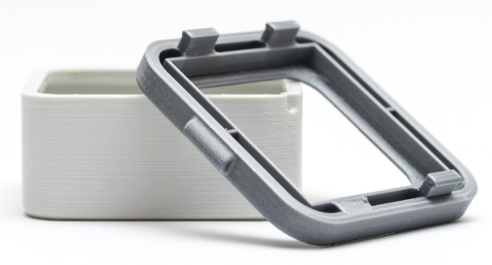
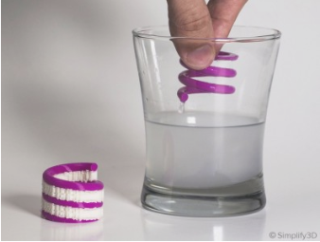
Materials
Mainly six types used
Polymers
Metals,
Concrete
Ceramics
Paper
Even Chocolate :)
Converted to filament in powder or liquid resin form.
Common Printer Materials
ABS (Acrylonitrile Butadiene Styrene)
Oil based plastic, stronger and more impact resistant (LEGOs), cheap
PLA (Polylactic Acid)
More brittle plastic, and more ecological -> Packaging Materials, cheap
PVA (Polyvinyl Alcohol)
Water soluble plastic, use for support for overhanging issues, $$$
Notes:
ABS vs. PLA: https://www.3dhubs.com/knowledge-base/pla-vs-abs-whats-difference#rules-of-thumb
PLA is ideal for 3D prints where aesthetics are important. Due to its lower printing temperature is easier to print with and therefore better suited for parts with fine details.
ABS is best suited for applications where strength, ductility, machinability and thermal stability are required.

Slide 6
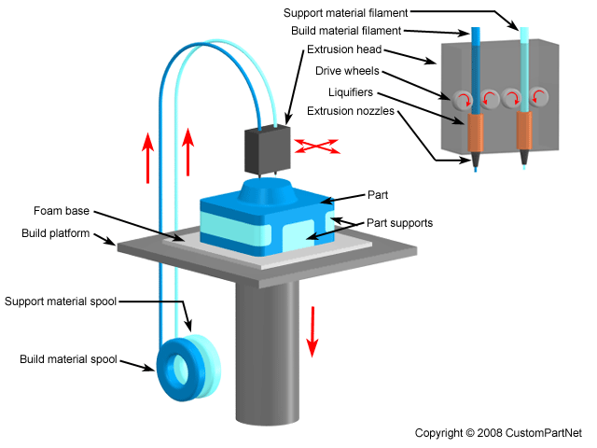
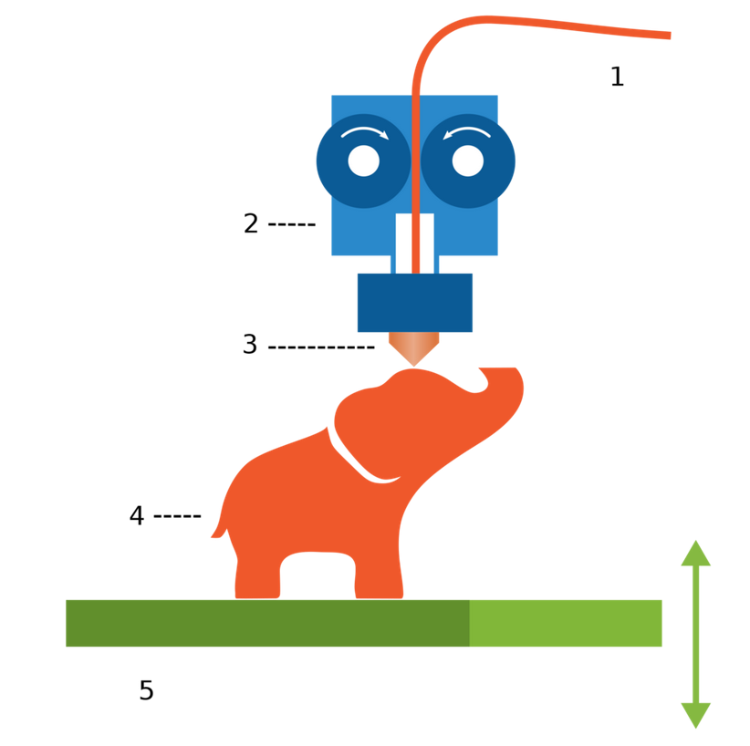
Types of Printers
Fused Deposition Modeling (FDM)
The most common type of printer, which prints by depositing hot material in layers to create a 3d product
Stereolithography
Which uses a liquid resin that hardens when exposed to wavelengths of light to “pull an object” out of the resin
Selective Laser Sintering (SLS)
uses lasers on powdery material to produce a hard final product. This is also an additive process so it happens in layers and the remainder of the material has to be cut away

Slide 7
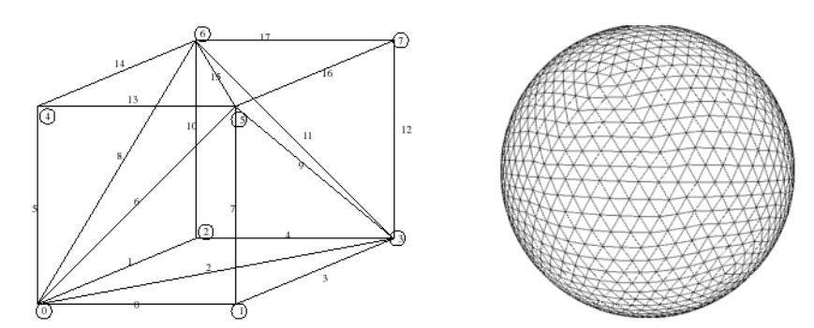
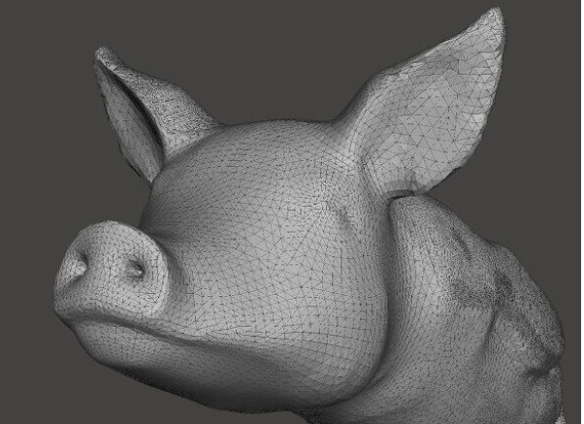
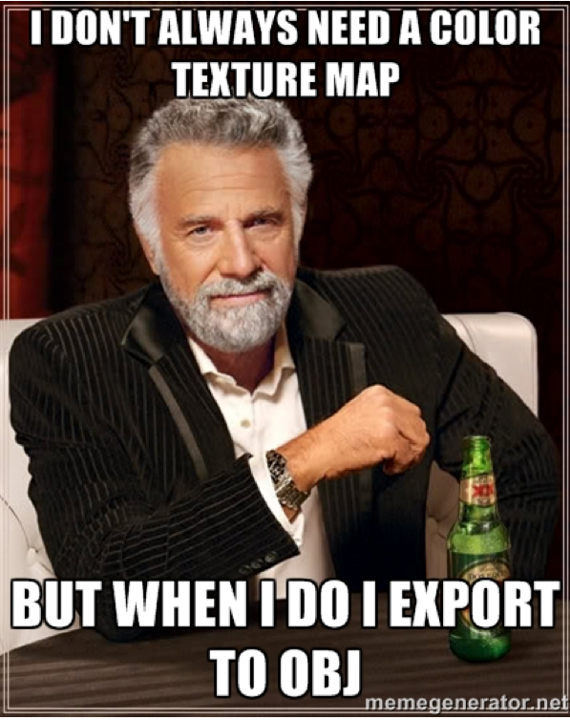
Software
3D Modeling Program (CAD)
We’ll be using Fusion 360
Ex: SketchUp, Solidworks
Outputs in stereolithography (STL) or OBJ
OBJ essentially captures color and texture elements with your 3D surface
(bettermodeling)
What is STL?
Type of file standing for Stereolithography, or Standard Tessellation Language
Utilizes a useful concept called Tessellation
Mesh of facet triangulation to approximate surface.
Resolution dependent on size of each triangle
Slicer Program
Outputs G-code
Customize printer resolution
Style of printing, infill
G-code goes in printer
Notes:
Triangulation is an interesting concept, a lot of cool math going behind the scenes.
Triangles simple enough for the computer to put together a whole bunch yet conveys enough information to create complex structures.

Slide 8
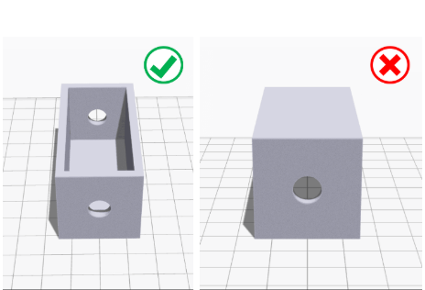
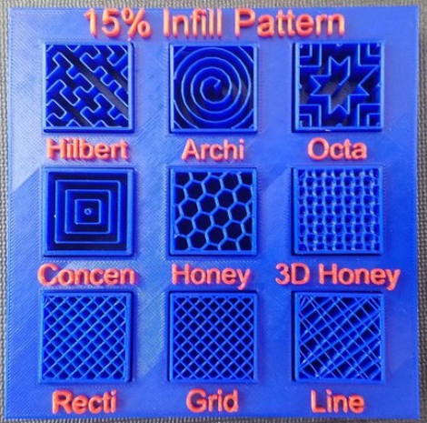
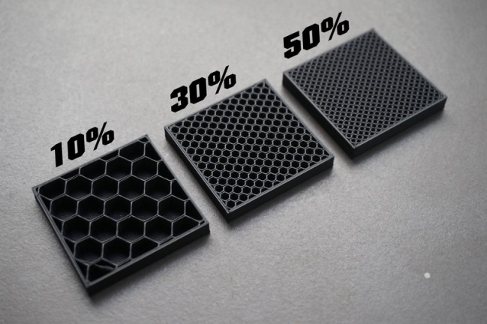
Tips for Design
Orientation to Minimize Support Materials
Plastic will expand ≅ 2mm (so undershoot)
Resolution
Print infill, hollow or solid
Exposure to UV light, Temp, Water

Slide 9
Creating a 3D Part
With Fusion and Ideamaker

Slide 10
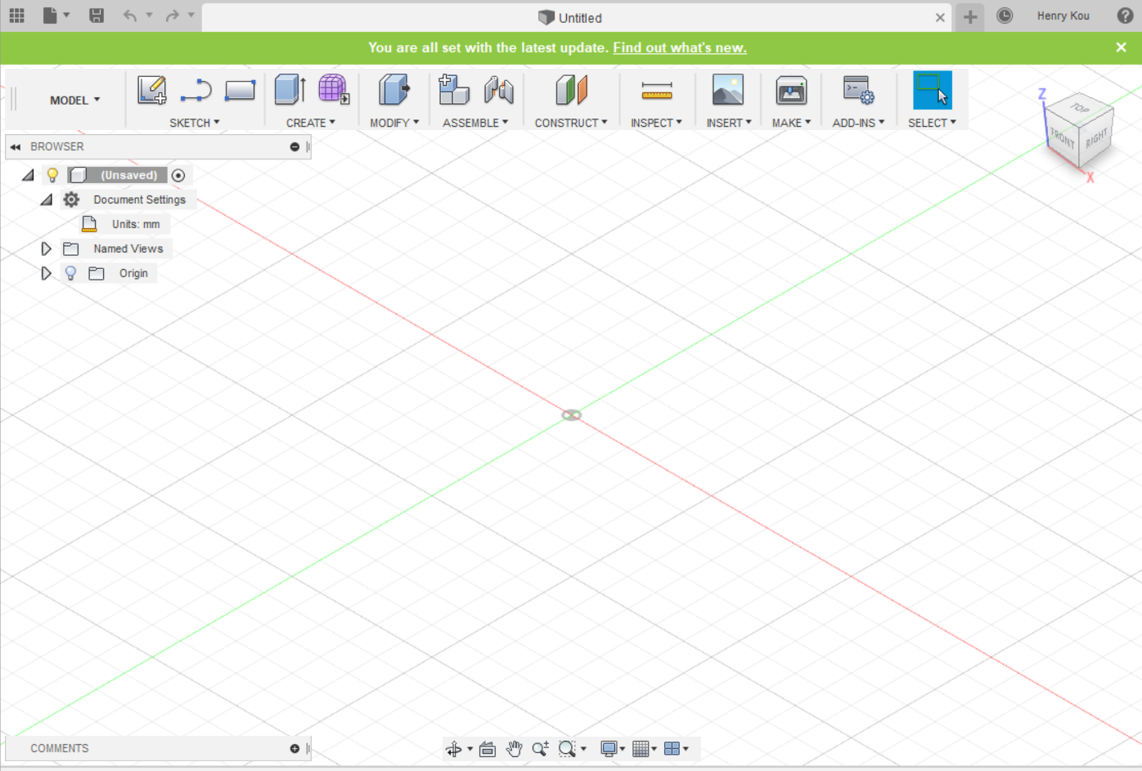
Setup
Make sure you are in Modeling Mode
Check Units
->Document Settings
Shortcuts:
S=Model Toolbox
Q=Push/Pull
C=Circle
D=Dimension
L=Line
X=Construction
P=Project
Ctrl+Z=Undo
J=Joint
ToolBar
Browser
Workspace
Remember to write this on the board Henry

Slide 11
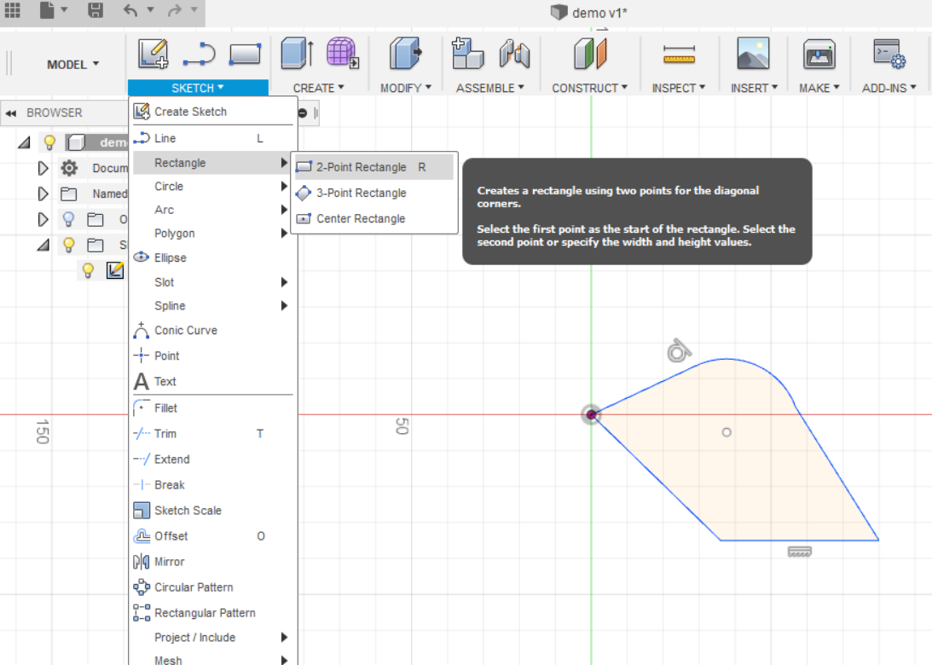
Creating a Sketch
- Using shortcuts, create a simple shape on a plane and edit with dimension (D) tool.
-You can overlap shapes together to create new ones.
-Make sure you connect all the endpoints
-Click Finish Sketch on the top right corner to stop editing sketch.
-You can revisit your sketch from the dropdown browser on the left side.
Creating a Sketch
Draw on workspace

Slide 12
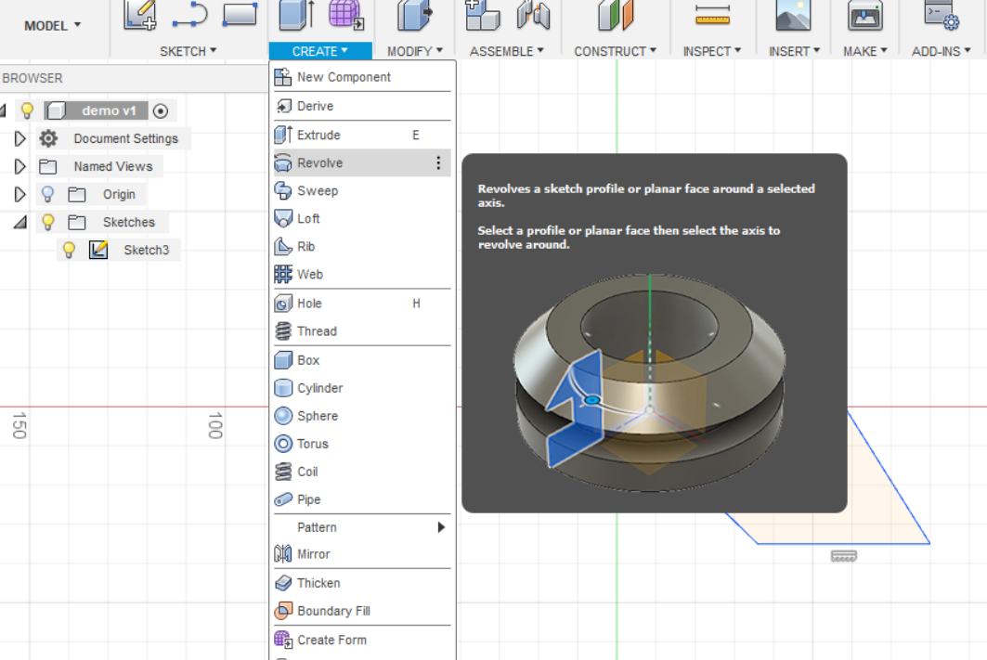
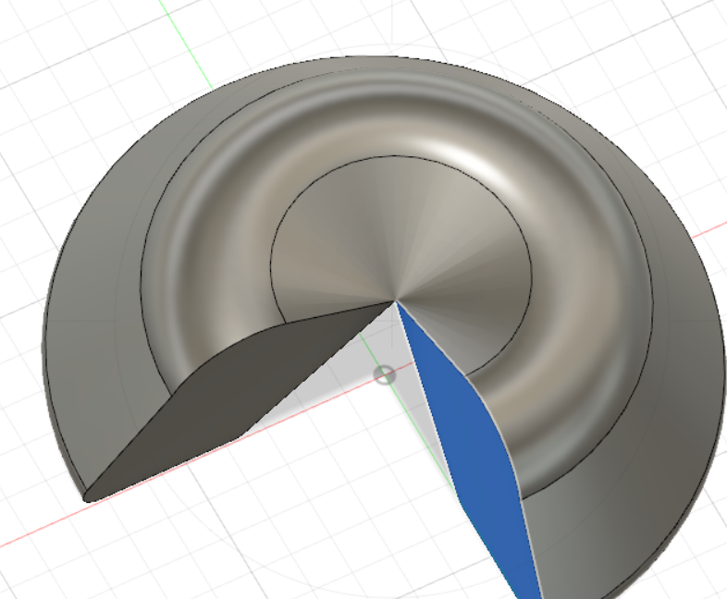
Modifying your Sketch
- Use the dropdown menus on the toolbar to access 3D actions.

Slide 13
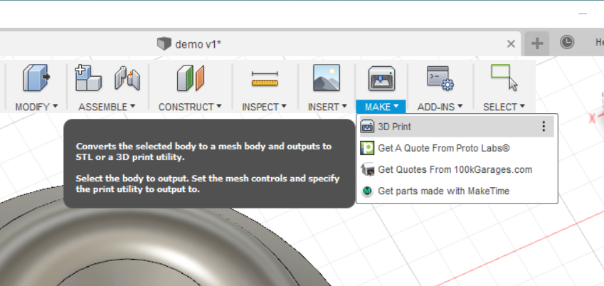
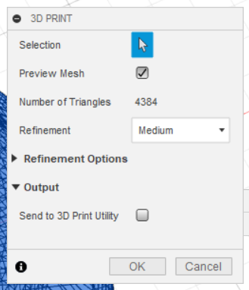
Exporting your part
-Once finished, click “Make” on upper right of the tool bar.
- Click 3D print. A menu should pop up.
-Select your entire part
-Uncheck “send to 3D print utility”
-You’re ready to export it to an STL file and import into ideamaker!!

Slide 14
Importing into Ideamaker
When opening Ideamaker for the first time you’ll be prompted to select a 3d printer
The makerspace uses Raise3D Pro2 Plus
Once you you’ve selected the printer youre ready to import

Slide 15
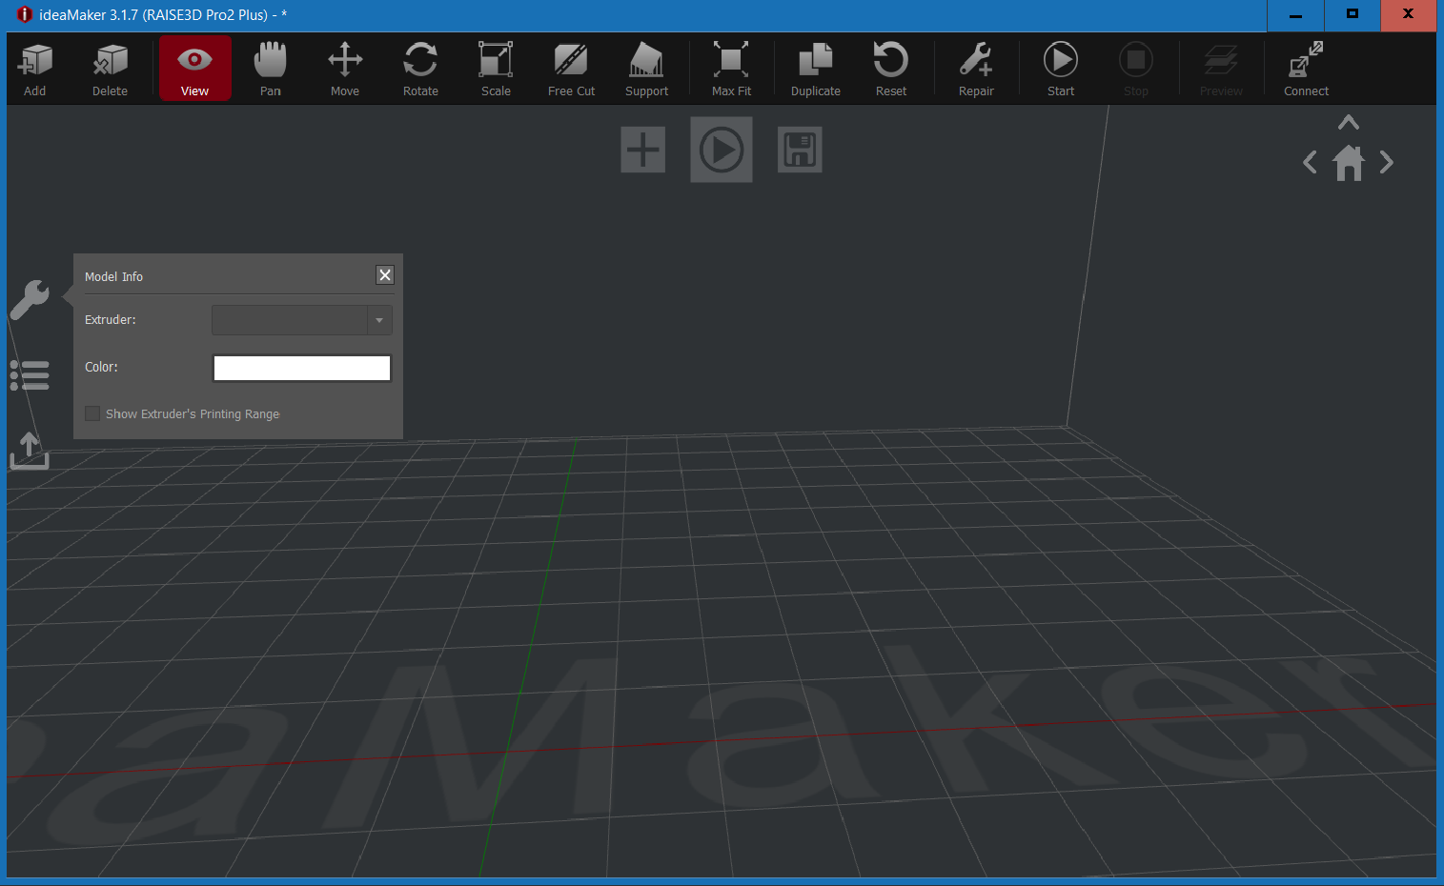
Use the add button to insert an OBJ or STL file

Slide 16
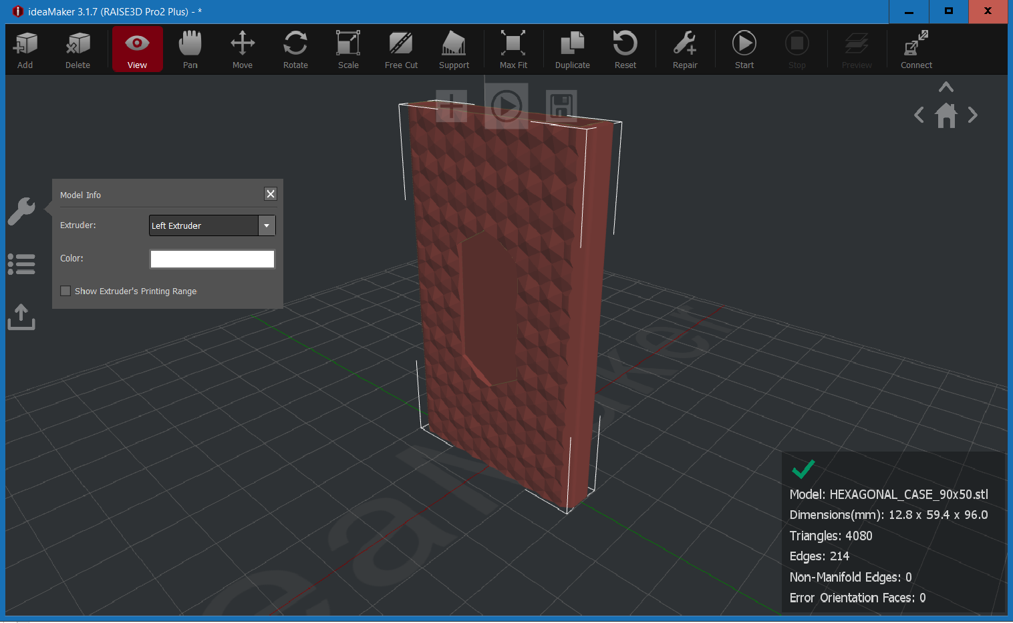
The pan button lets you drag your view in the x,y,z plane rather than the around the object
Use the view button to orient your view of the object

Slide 17
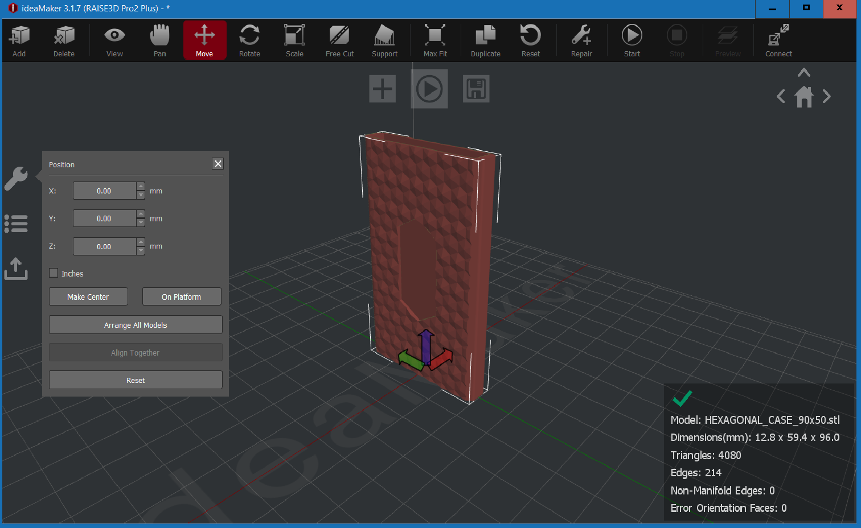
The move button lets you move the object in x,y,z directions or the display on the left lets you specify where on the plane

Slide 18
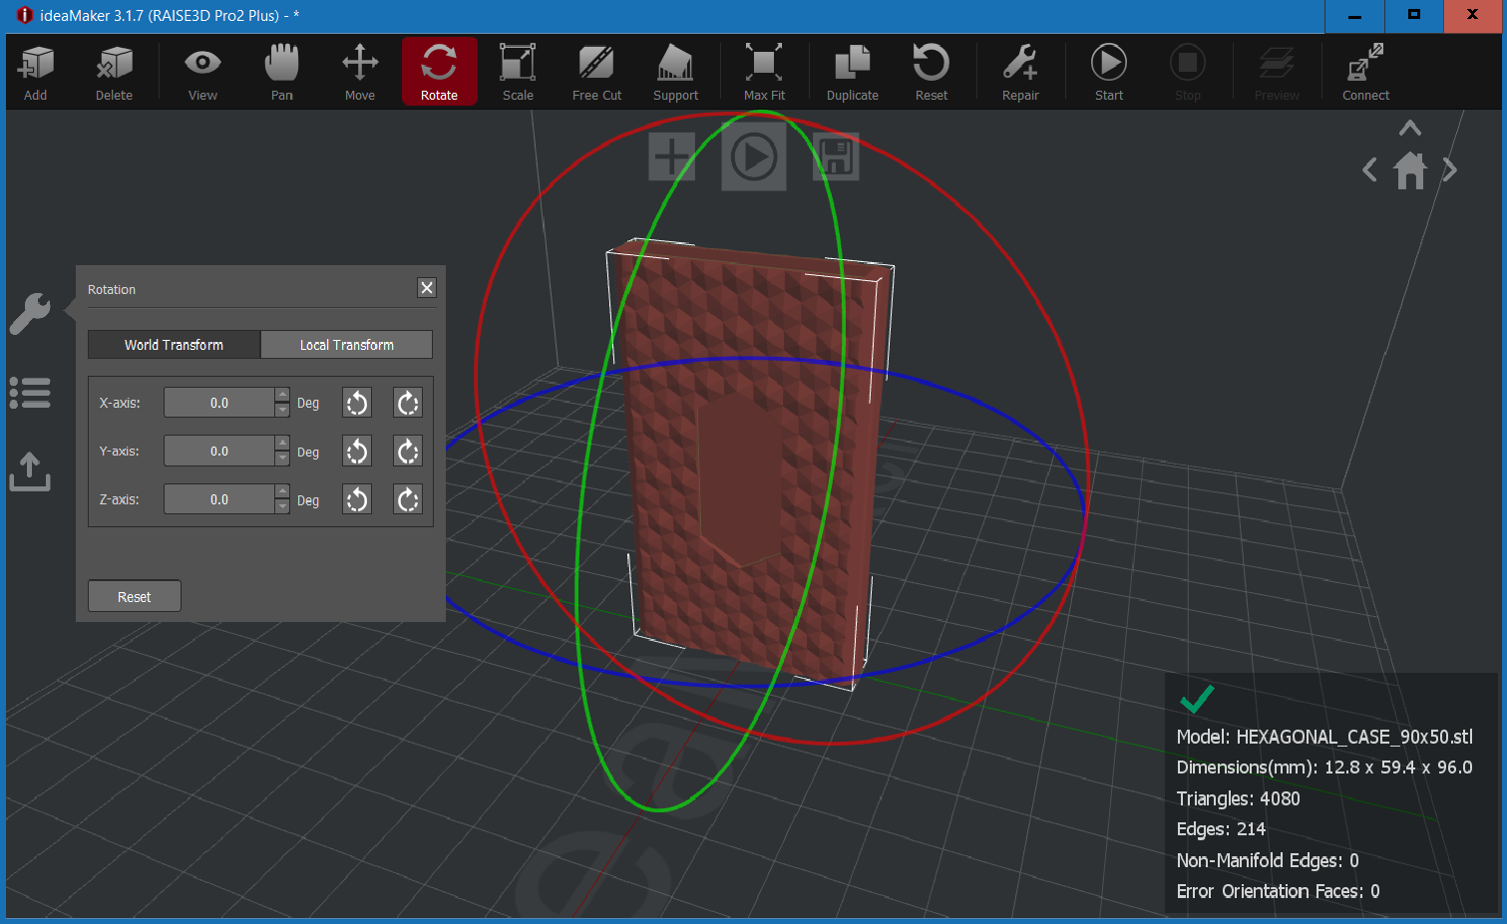
The rotate button lets you rotate the object along an axis. The buttons on the left do 90 degree rotations

Slide 19
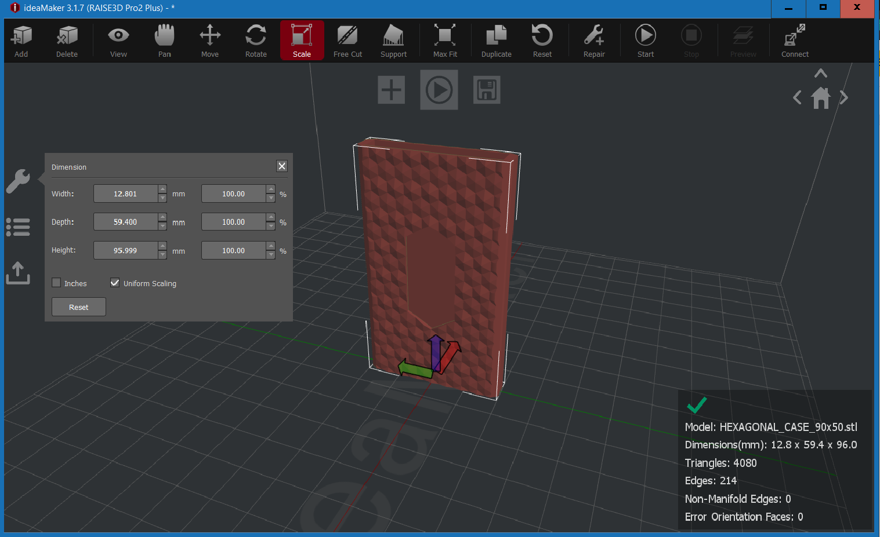
Scaling changes the dimension of the object and can be done as a scalar multiple or individually to width depth or height

Slide 20

When ready hit the start button

Slide 21
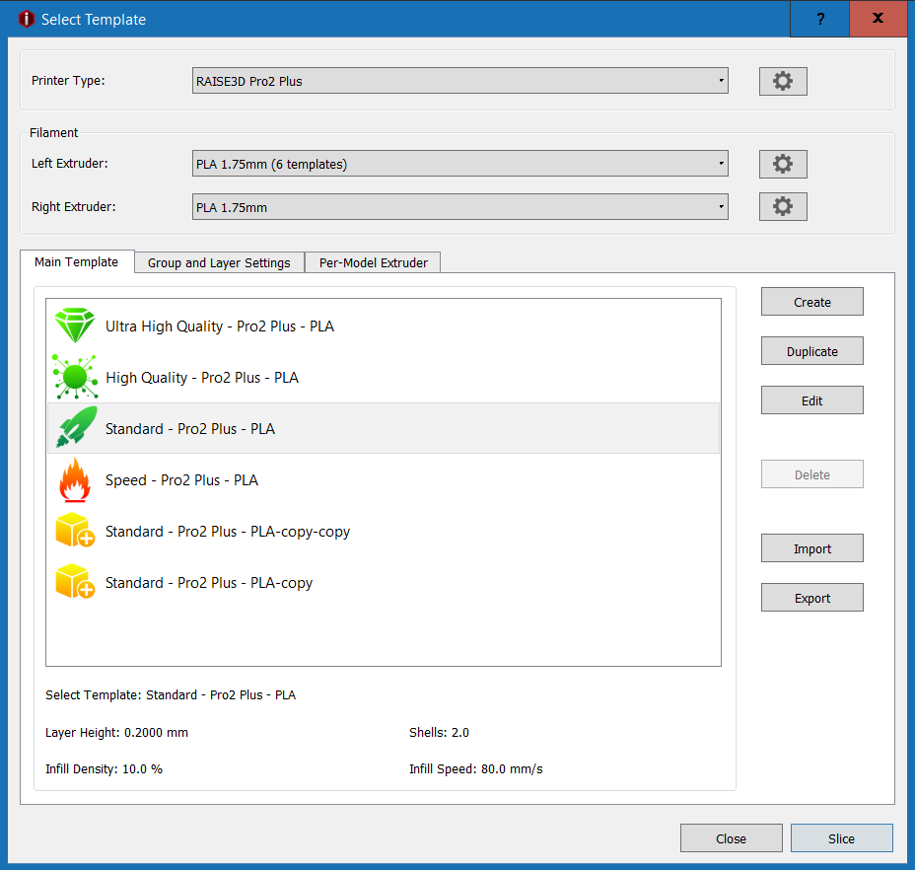
Depending on the printer you plan to use, select PLA or ABS 1.75mm and standard quality for the print and hit edit so you can turn the auto supports on
Slicing produces the gcode file that the printer uses

Slide 22
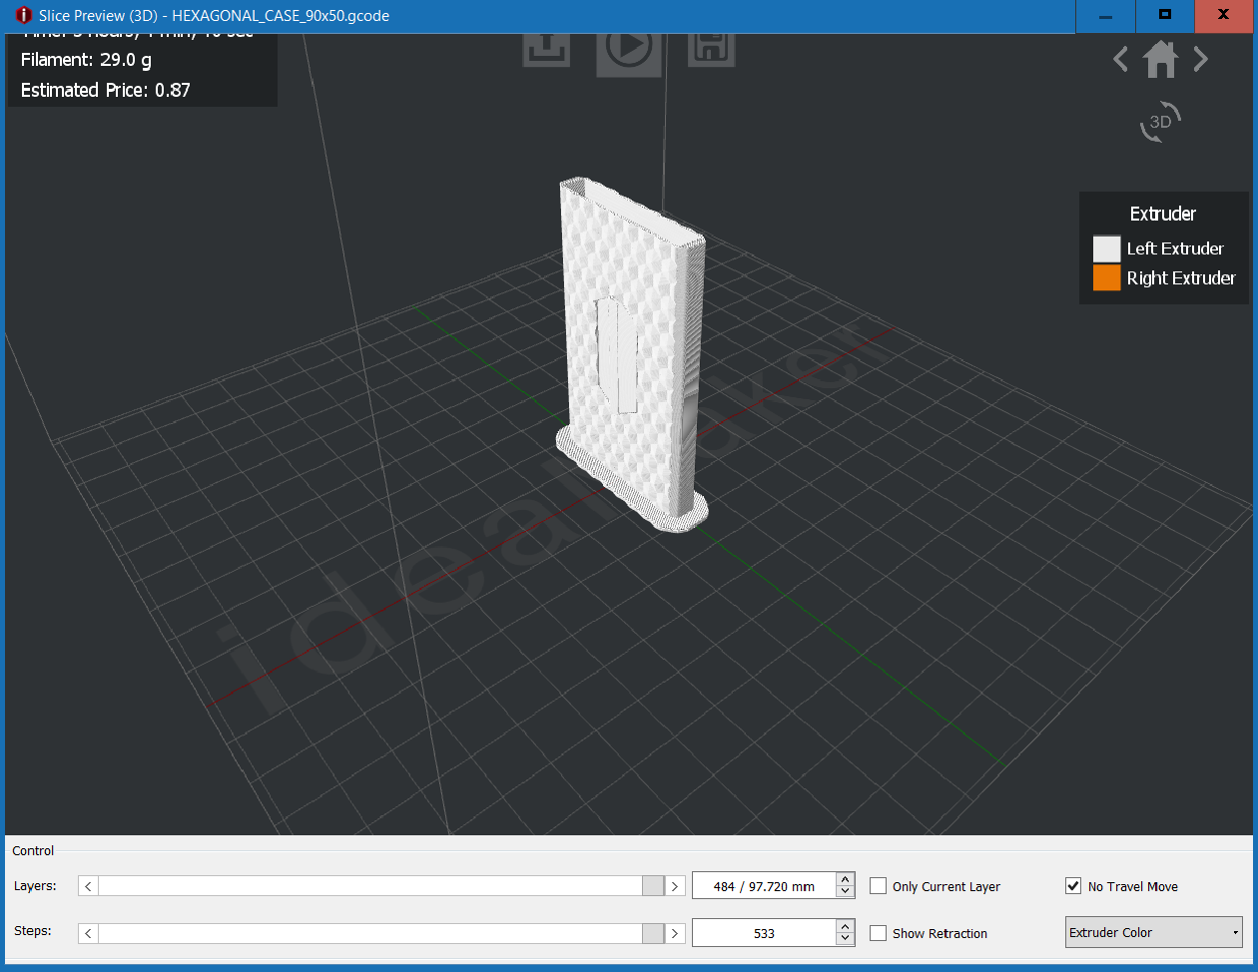
In the preview, you can look at the layers to see how the print will go and see any points where a potential error may occur

Slide 23
Final Steps
The final step is to export the code to a usb
The makerspace has usbs in the printers that you can use
When a printer is open, put in the usb and then find your gcode file on it (a good name for the model helps)
Look at the model on the screen to make sure its correct
Some models don’t show up which could mean an error could occur while printing

Slide 24
PrusaSlicer
For the prusaslicer, when opening just select the default settings for what shows up
After that you’ll be in the normal environment and can add objects

Slide 25
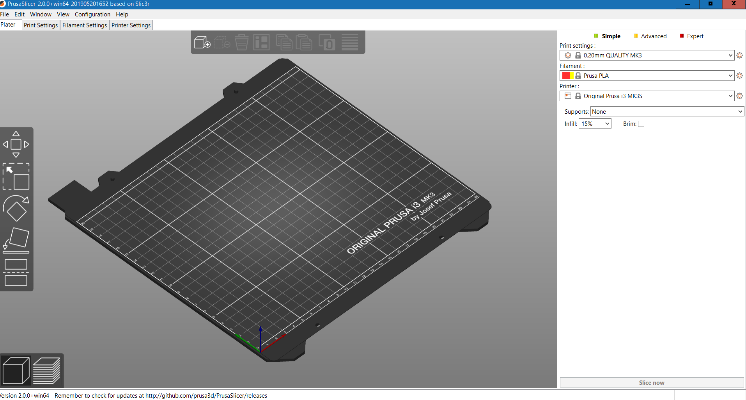
This is the add object button, you can use it to add obj and stl objects

Slide 26
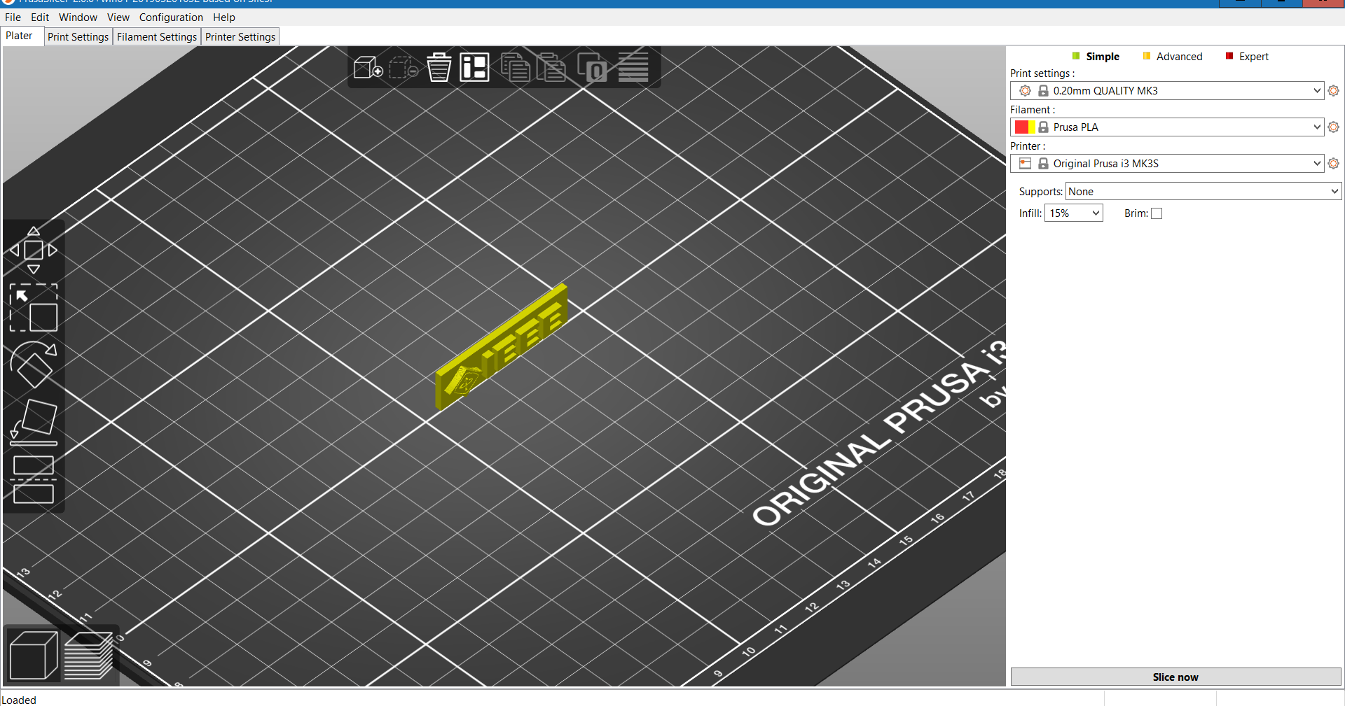
The move button lets you position objects
The scale button lets you change the dimensions of an object

Slide 27
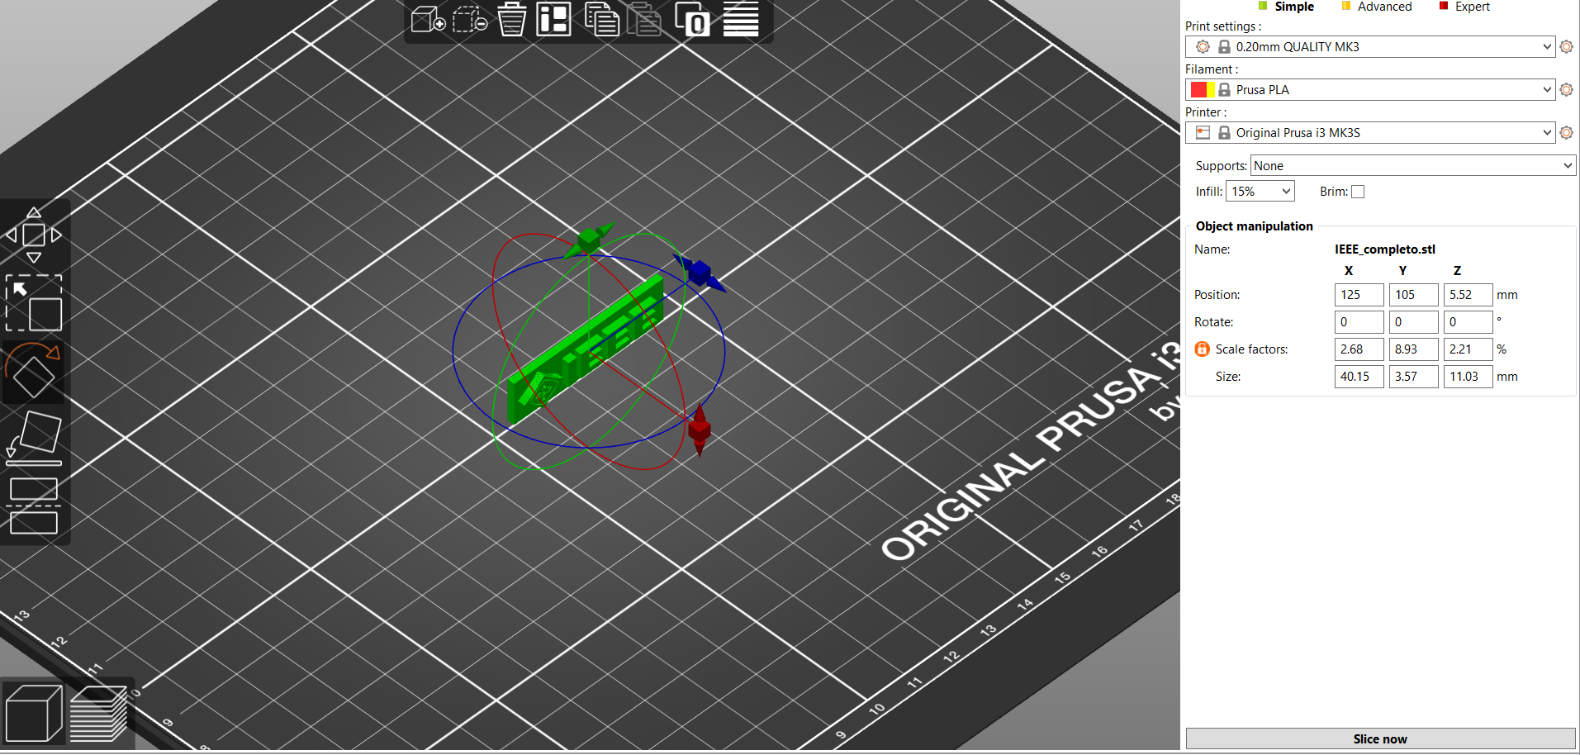
The place on face button lets you choose an object face to put on the printer surface
The rotate button lets you change orientation

Slide 28
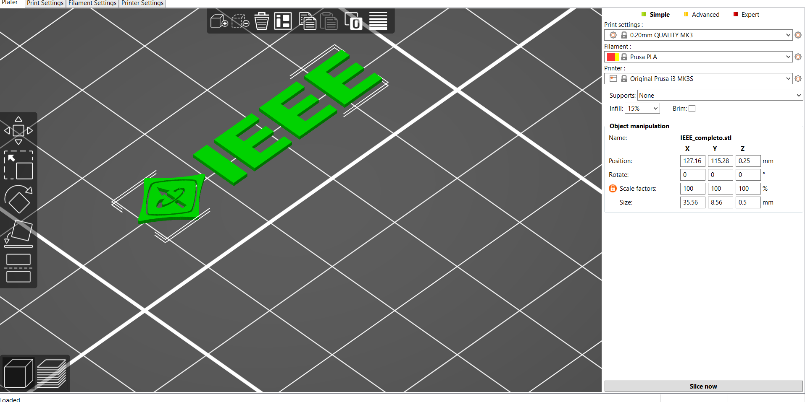
The cut button lets you take a cut of an object and use just that portion. There’s multiple options associated with this

Slide 29
Finishing up
When ready, check your settings for the material you’re using and slice
There is also a preview option for the print and shows you the layers that will be made
When ready export it to gcode and then upload it to an sd card to put on the prusa

Slide 30
MOD-t in the IEEE lab
Here are some instructions for using the mod-t printer in the lab
https://drive.google.com/open?id=1VbHkTud3Eo-oBzgM644hdd4PfhhV1pePqH7RIQaI8gk

Slide 31
Works cited
Materials
https://www.tomsguide.com/us/3d-printing-materials,news-24392.html
Types of Printers
https://penandplastic.com/3d-printer-types/
Useful Video
https://www.youtube.com/watch?v=A5bc9c3S12g

